Slide 1
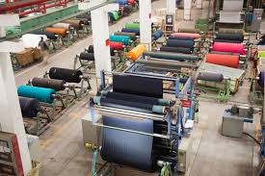
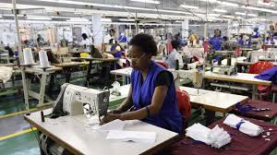
Title: EFFECTIVENESS OF THE CLOTHING AND TEXTILE COMPETITIVENESS PROGRAMME (CTCP)
PREPARED BY: MRS P A MANGAKANE
Student Number: 213562231
Date: 4 August2015

Slide 2
SCOPE
Context
Research Objective
Research Framework
Research Question
Definition and Deliniation
Research Strategy
Research Material
Research Planning

Slide 3
CONTEXT
The South African textile Industry in 2013 accounted for 14 % of the manufacturing employment.
The textile Industry has been declining resulting to job losses of more than 85000 in the period of 1996 to 2005 due to the various challenges amongst others:
Competition from Asian countries due to their advantage of low costs of labour resulting to imports of cheaper textiles inflow into the country
Increasing costs of inputs Industry stakeholders include:
Supply chain consists of :
Raw material producers
Users
Fabric manufactures
Retailers
Clothing manufactures

Slide 4
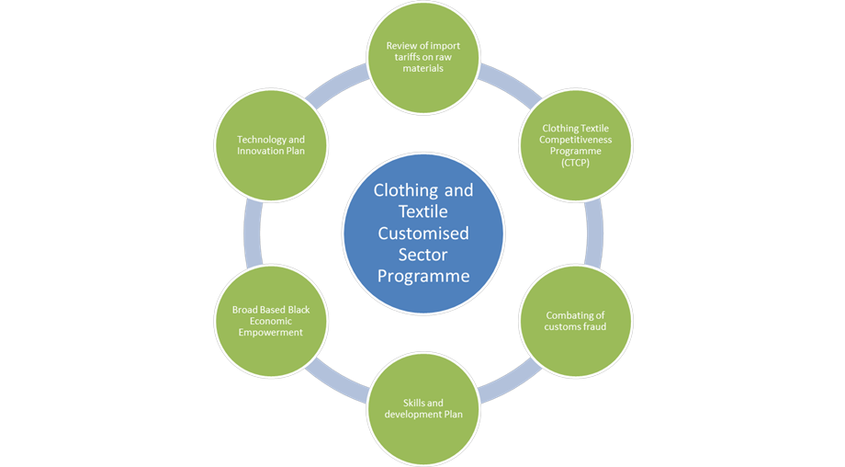
CONTEXT
Interventions to improving the textile industry
Trade and investment expansion with the United States, through the US’ African Growth and Opportunity Act (AGOA) signed.
Trough the DTI’s strategic approach, initiated a Clothing Textile Customised Sector Programme (CSP) with the objective of ensuring the long term sustainability and competitiveness of the industry.
The CSP’s main objective is to assist the industry in upgrading processes, products and people to re-position it so it can compete effectively against other low cost producing countries.
Six pillars of the CSP

Slide 5
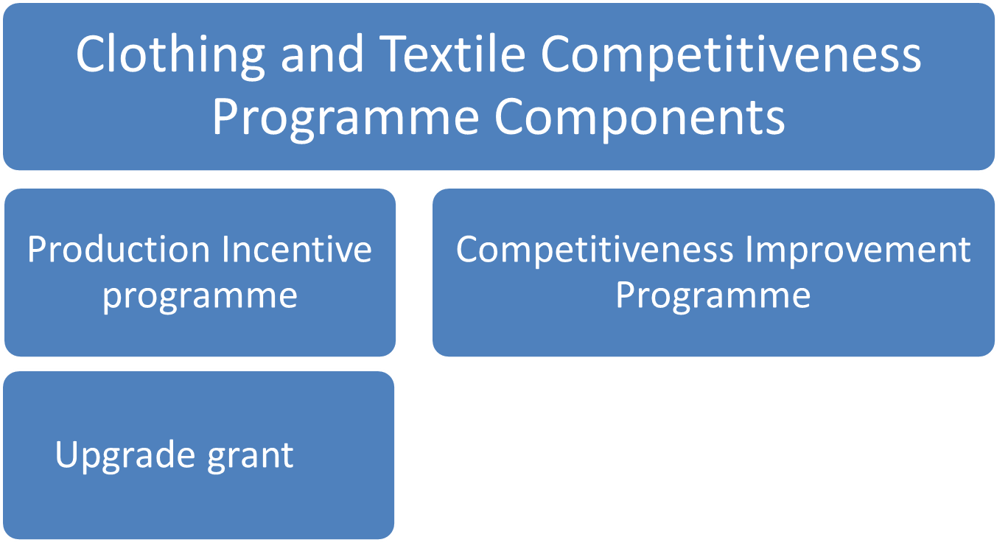
CONTEXT
The research is focused on the CTCP consisting of:
The research aims to assess to what extent the CTCP meets its objectives to avoid the spray and pray approach where funding is hoped to solve the experienced challenges and also to avoid fruitless and wasteful expenditure.

Slide 6
Research Objective
The objective of the research is to evaluate the effectiveness of the Clothing and Textile Competitiveness Programme by conducting a case study on small, medium and large enterprises in three major provinces and recording the findings to provide possible recommendations on how the programme can be improved. The focus will be on the a) productivity, b)innovation c) production incentive metric.

Slide 7
RESEARCH FRAME WORK
Industrial Policy Action Plan
Production Incentive Programme
CTCP Programme Guidelines
Theory on Production and Operations Management
Programme Effectiveness
Findings and Recommendations
Evaluation Results
Product Quality Theory
Assessment Criteria for the effectiveness of CTCP
Labour Policies
Preliminary Research
Competitiveness Improvement
Programme

Slide 8
RESEARCH FRAME WORK
A study on the effectiveness of the CTCP based on the relevant literature on the policy for industrial action plan and labour, guidelines on the production incentive programme and on the competitiveness improvement programme, theory on product quality, production and operations management as well as preliminary research through interviews with the stakeholders yields to the development of an assessment criteria
by means which the effectiveness of CTCP applied to small, medium and large clothing and textile companies in the regions of Western Cape, Kwa-Zulu Natal and Gauteng can be evaluated
evaluations results will be arrived at
which will yield to the findings of the evaluation results being reported on and used to derive possible recommendations for improving the programme effectiveness .

Slide 9
RESEARCH QUESTIONS
What criteria are relevant for evaluating the effectiveness of the CTCP?
What are the fundamental principles of the programme?
What is the measurement of the effectiveness of the production incentive programme ?
What is the production incentive (PI) metric formula based on?
In what way can its application be measured to all the company sizes?
What is a measure of productivity?

Slide 10
RESEARCH QUESTIONS
What is the measurement of the effectiveness of the competitiveness programme?
What is innovation?
To what extend has the programme contributed to innovation?
Based on the evaluation results what recommendations could be derived for improving the effectiveness of the CTCP?

Slide 11
DEFINTIONS
Effectiveness is the degree to which the CTCP is successful to produce the desired results.
Competitiveness encompasses issues of cost, quality, flexibility, reliability, adaptability and the capability to innovate.
Competitiveness improvement interventions include innovative activities related to people, products, processes and market development.

Slide 12
DELINIATION
Production Incentive Programme
Upgrade grant
Production Incentive Metric
Productivity
Fabric manufacturers
Clothing manufacturers
Effectiveness of CTCP
Competitiveness Improvement
Programme
Innovation
Fabric manufacturers
Clothing manufacturers

Slide 13
RESEARCH STRATEGY
Case Study
Interviews

Slide 14
RESEARCH MATERIAL
Primary data (organisational documents)
Media releases
Literature (Journals, Handbooks, Conference and Seminar papers)
Questionnaire

Slide 15
RESEARCH PLANNING

Slide 16


THANK YOU

